Slide 1
Logistic Regression

Slide 2
Contents

Slide 3
Contents
•What is the need of logistic regression?
•Building logistic Regression line
•Goodness of fit measures
•Multicollinearity
•Individual Impact of variables
•Model selection

Slide 4
What is the need of non-linear
regression?

Slide 5
LAB: What is the need of logistic regression?
•Dataset: Product Sales Data/Product_sales.csv
•What are the variables in the dataset?
•Build a predictive model for Bought vs Age
•What is R-Square?
•If Age is 4 then will that customer buy the product?
•If Age is 105 then will that customer buy the product?

Slide 6
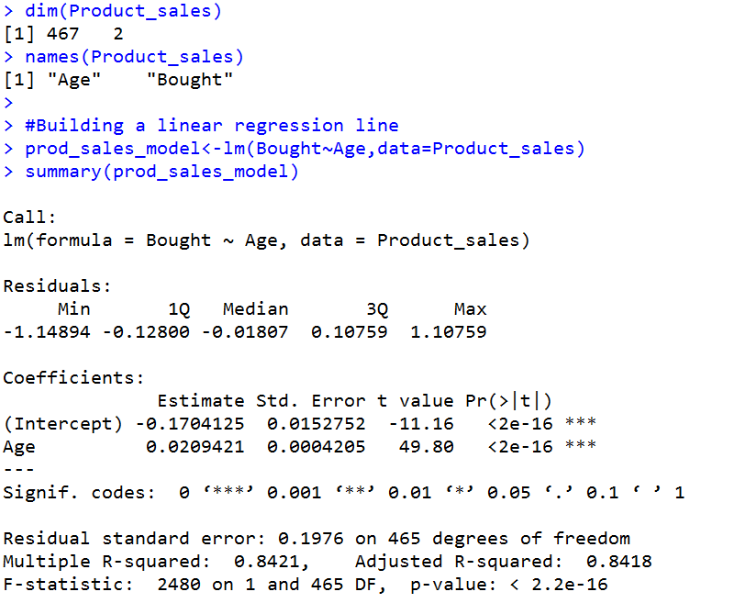
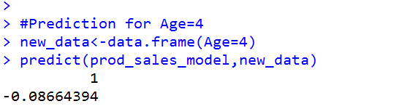
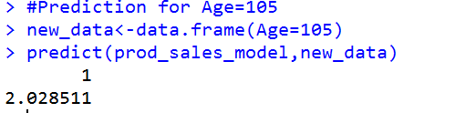
Code - What is the need of logistic regression?

Slide 7
Something wrong
•The model that we built above is not right.
•There is certain issues with the type of dependent variable
•The dependent variable is not continuous it is binary
•We can’t fit a linear regression line to this data

Slide 8
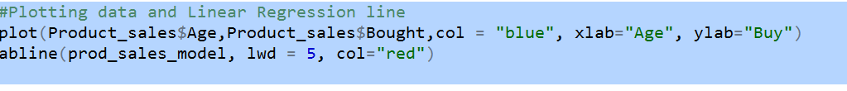
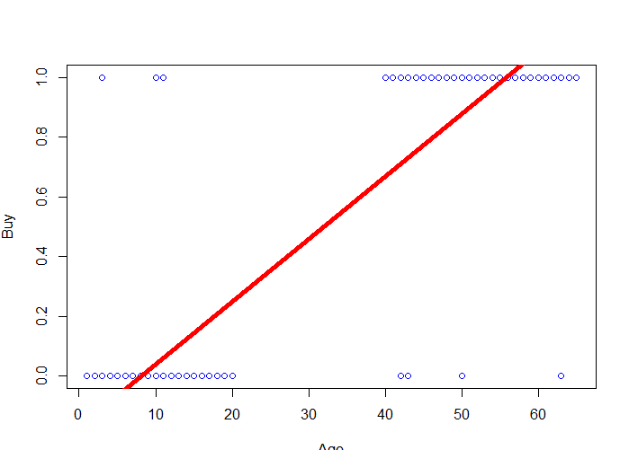
Linear Regression line for above data

Slide 9
Why not linear ?

Slide 10
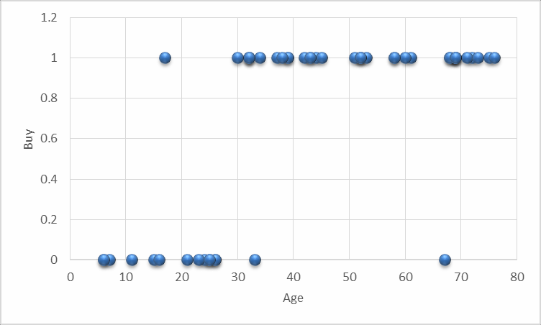
Why not linear ?
•Consider Product sales data. The dataset has two columns.
Age – continuous variable between 6-80
Buy(0- Yes ; 1-No)

Slide 11

Why not linear ?
No
Yes
0
10
20
30
40
Age
50
60
70
80

Slide 12
Real-life examples
•Gaming - Win vs. Loss
•Sales - Buying vs. Not buying
•Marketing – Response vs. No Response
•Credit card & Loans – Default vs. Non Default
•Operations – Attrition vs. Retention
•Websites – Click vs. No click
•Fraud identification –Fraud vs. Non Fraud
•Healthcare –Cure vs. No Cure

Slide 13
A Logistic Function

Slide 14
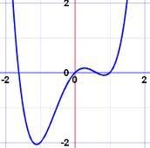
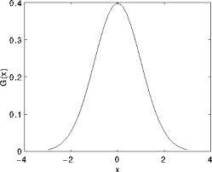
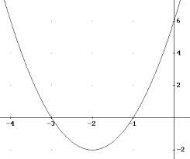
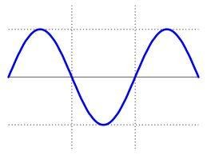
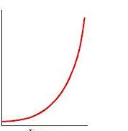
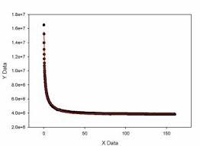
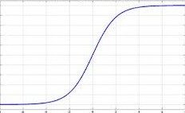
Some Nonlinear functions
Gaussian
polynomial
Quadratic
Exponentia
Sine
l
Double
Logistic
exponential

Slide 15
A Logistic Function
1.2
No
1
0.8
0.6
0.4
0.2
Yes
0
0
10
20
30
40
50
60
70
80
Age

Slide 16
The Logistic function
• We want a model that predicts probabilities between 0 and 1, that is, S-
shaped.
• There are lots of s-shaped curves. We use the logistic model:
• Probability = exp(β₀+ β₁X) /[1 + exp(β₀+ β₁X) ]
1.0
α +βx
e
P( y x) =
_{1 + e}α +βx
0.8
0.6
0.4
0.2
0.0

Slide 17
Logistic Regression Output
•In logistic regression, we try to predict the probability instead of
direct values
•Y is binary, it takes only two values 1 and 0 instead of predicting 1 or 0 we predict the probability of 1 and probability of zero
•This suits aptly for the binary categorical outputs like YES vs NO; WIN vs LOSS; Fraud vs Non Fraud

Slide 18
Logistic Regression Line

Slide 19
Lab: Logistic Regression
•Dataset: Product Sales Data/Product_sales.csv
•Build a logistic Regression line between Age and buying
•A 4 years old customer, will he buy the product?
•If Age is 105 then will that customer buy the product?

Slide 20
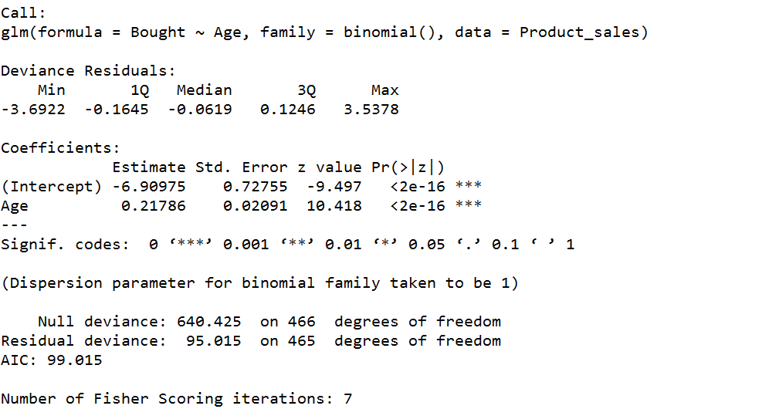
Code: Logistic Regression

Slide 21
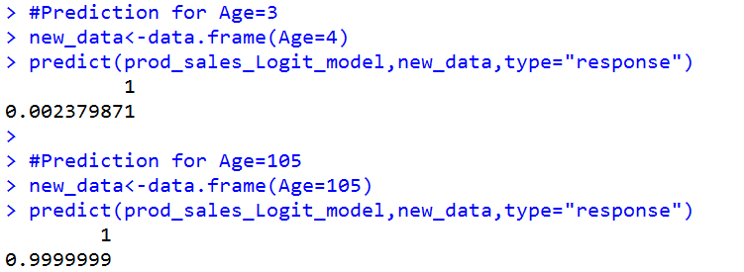
Code: Logistic Regression

Slide 22
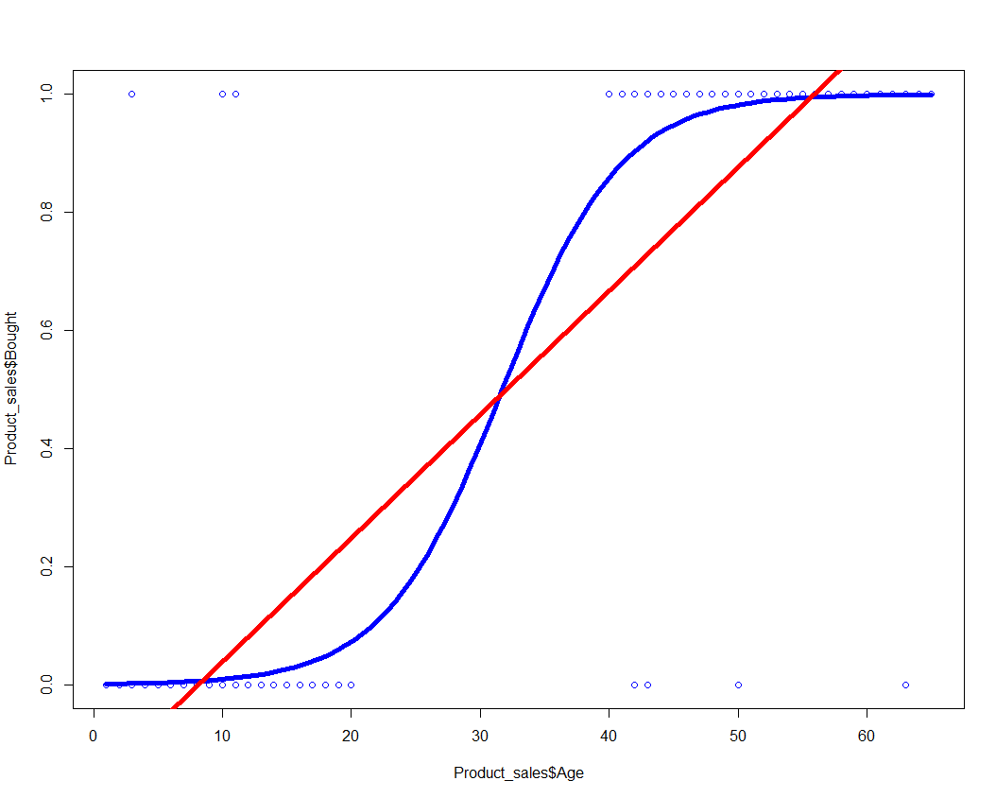
Code: Logistic Regression

Slide 23
Multiple Logistic Regression

Slide 24
Multiple Logistic Regression
•The dependent variable is binary
•Instead of single independent/predictor variable, we have multiple predictors
•Like buying / non-buying depends on customer attributes like age, gender, place, income etc.,

Slide 25
LAB: Multiple Logistic Regression
•Dataset: Fiberbits/Fiberbits.csv
Active_cust variable indicates whether the customer is active or already left the network.
•Build a model to predict the chance of attrition for a given customer
using all the features.
•How good is your model?
•What are the most impacting variables?

Slide 26
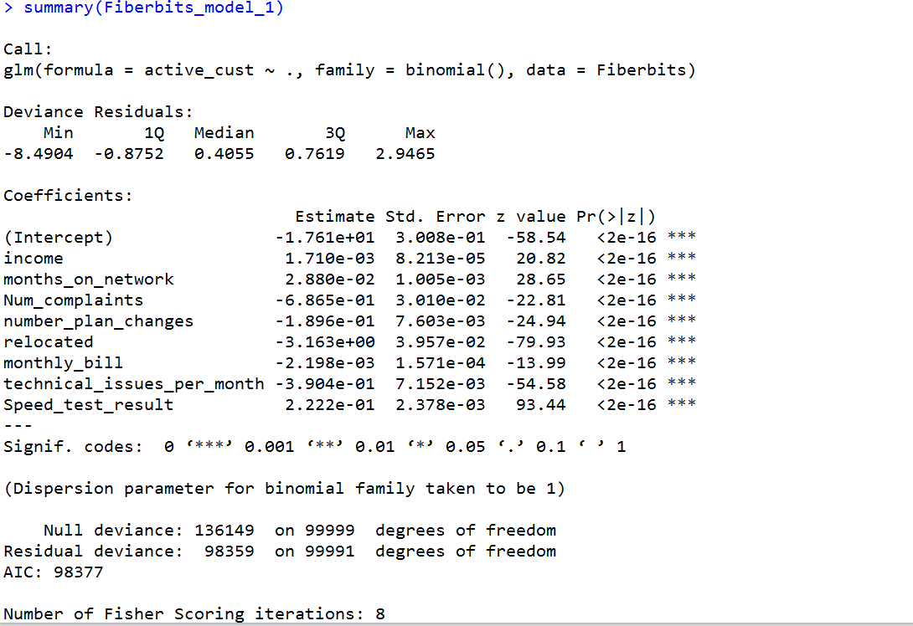
Code: Multiple Logistic Regression

Slide 27
Goodness of fit for a logistic
regression

Slide 28
Goodness of fit for a logistic regression
•Classification Matrix
•AIC and BIC
•ROC & AUC – Area under the curve

Slide 29
Classification Table & Accuracy
Predicted
 | 0 | 1
0 | True positive (TP) | False Negatives(FN)
1 | False positive (FP) | True Negatives(TN)
Actual
Also known as confusion matrix
Accuracy=(TP+TN)/(TP+FN+FP+TN)

Slide 30
Classification Table
Sensitivity and Specificity are derived from confusion matrix
Predicted Classes
 | 0(Positive) | 1(Negative)
0(Positive) | True positive (TP) Actual condition is Positive, it is truly predicted as positive | False Negatives(FN) Actual condition is Positive, it is falsely predicted as negative
1(Negative) | False Positives(FP) Actual condition is Negative, it is falsely predicted as positive | True Negatives(TN) Actual condition is Negative, it is truly predicted as negative
Actual Classes
Accuracy=(TP+TN)/(TP+FP+FN+TN)
Misclassification Rate=(FP+FN)/(TP+FP+FN+TN)

Slide 31
LAB: Confusion Matrix & Accuracy
•Create confusion matrix for product sales model and find the accuracy
•Create confusion matrix for Fiber bits model
•Find the accuracy value for fiber bits model
•Change try three different threshold values and note down the changes in accuracy value

Slide 32
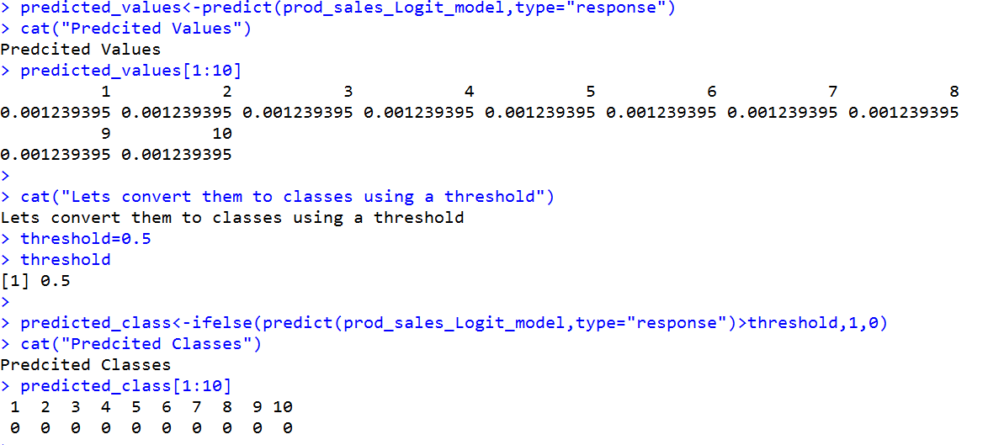
Code: Confusion Matrix & Accuracy

Slide 33
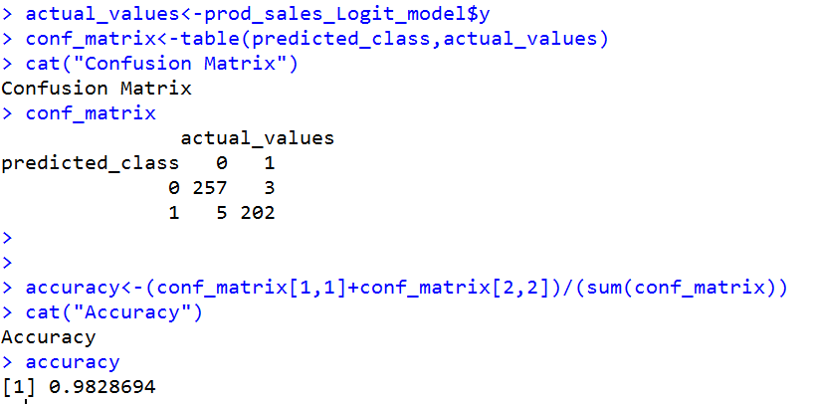
Code: Confusion Matrix & Accuracy

Slide 34
Multicollinearity

Slide 35
Multicollinearity
•The relation is between X and Y is non linear, we used logistic
regression
•The multicollinearity is an issue related to predictor variables.
•Multicollinearity need to be fixed in logistic regression as well.
•Otherwise the individual coefficients of the predictors will be effected by the interdependency
•The process of identification is same as linear regression

Slide 36
LAB-Multicollinearity
Is there any multicollinearity in fiber bits model?
Identify and remove multicollinearity from the model

Slide 37
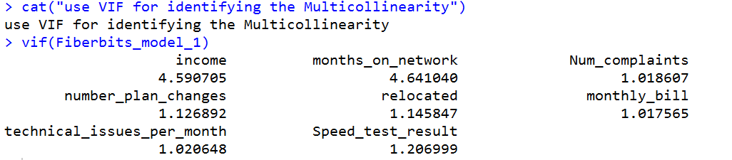
Code-Multicollinearity

Slide 38
Individual Impact of Variables

Slide 39
Individual Impact of Variables
•Out of these predictor variables, what are the important variables?
•If we have to choose the top 5 variables what are they?
•While selecting the model, we may want to drop few less impacting variables.
•How to rank the predictor variables in the order of their importance?

Slide 40
Individual Impact - z values& Wald chi- square
•We can simply look at the z values of the each variable. Look at their
absolute values
•Or calculate the Wald chi-square, which is nearly equal to square of the z-score
•Wald Chi-Square value helps in ranking the variables

Slide 41
LAB: Individual Impact of Variables
•Identify top impacting and least impacting variables in fiber bits
models
•Find the variable importance and order them based on their impact

Slide 42
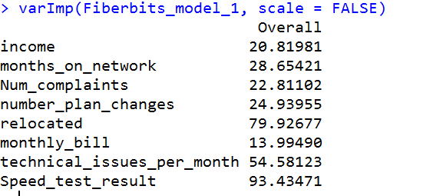
Code: Individual Impact of Variables

Slide 43
Model Selection

Slide 44
How to improve model
•By adding more independent variables?
•By deriving new variables from available set?
•By transforming variables ?
•By collecting more data?
•How do we choose best model from the list of fitted models with different parameters

Slide 45
AIC and BIC
•AIC and BIC values are like adjusted R-squared values in linear
regression
•Stand-alone model AIC has no real use, but if we are choosing between the models AIC really helps.
•Given a collection of models for the data, AIC estimates the quality of each model, relative to each of the other models
•If we are choosing between two models, a model with less AIC is
preferred
•AIC is an estimate of the information lost when a given model is used to represent the process that generates the data

Slide 46
AIC and BIC
•AIC= -2ln(L)+ 2k
L be the maximum value of the likelihood function for the model
k is the number of independent variables
•BIC is a substitute to AIC with a slightly different formula. We will
follow either AIC or BIC throughout our analysis

Slide 47
LAB-Logistic Regression Model Selection
•Find AIC and BIC values for the first fiber bits model(m1)
•What are the top-2 impacting variables in fiber bits model?
•What are the least impacting variables in fiber bits model?
•Can we drop any of these variables and build a new model(m2)
•Can we add any new interaction and polynomial variables to increase the accuracy of the model?(m3)
•We have three models, what the best accuracy that you can expect on
this data?

Slide 48
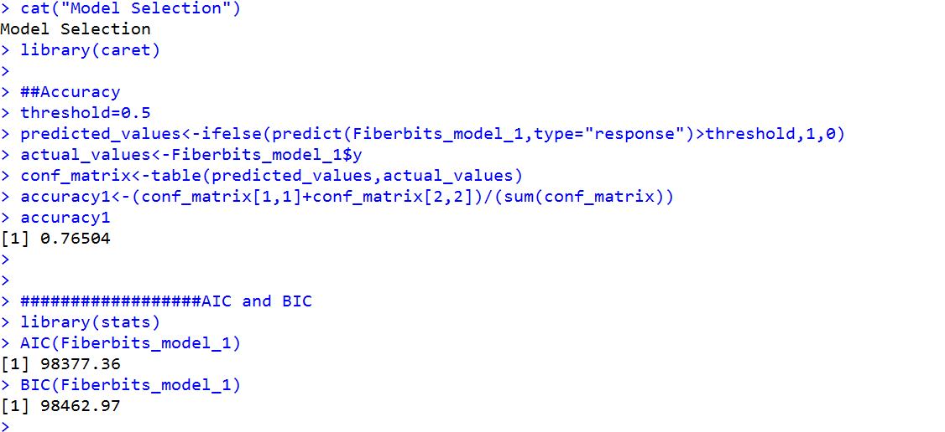
Code-Logistic Regression Model Selection

Slide 49
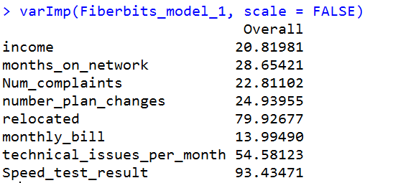
Code-Logistic Regression Model Selection

Slide 50
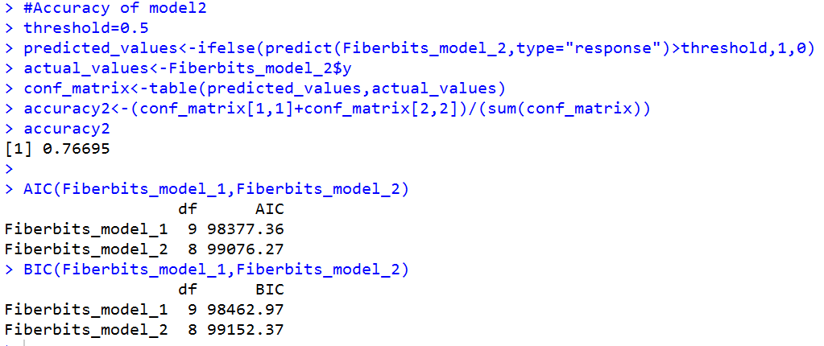
Code-Logistic Regression Model Selection

Slide 51
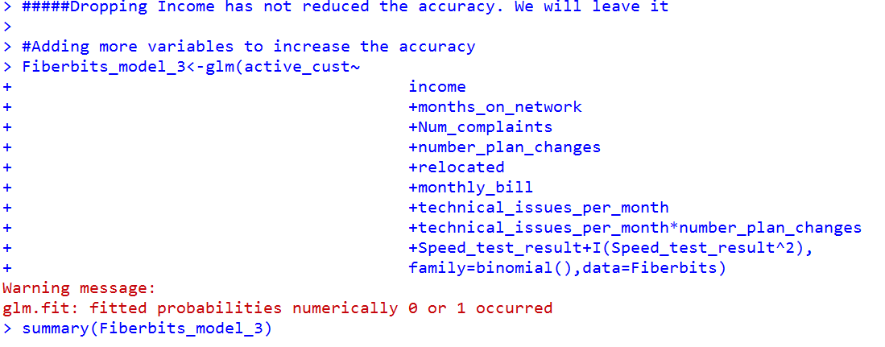
Code-Logistic Regression Model Selection

Slide 52
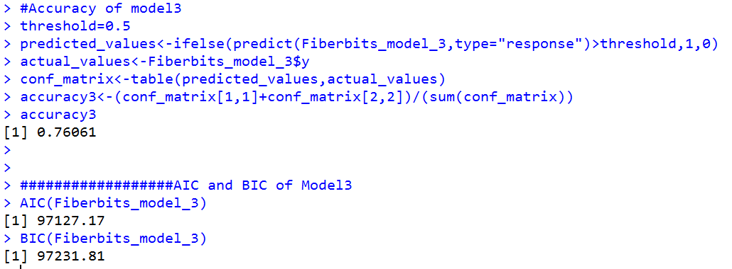
Code-Logistic Regression Model Selection

Slide 53
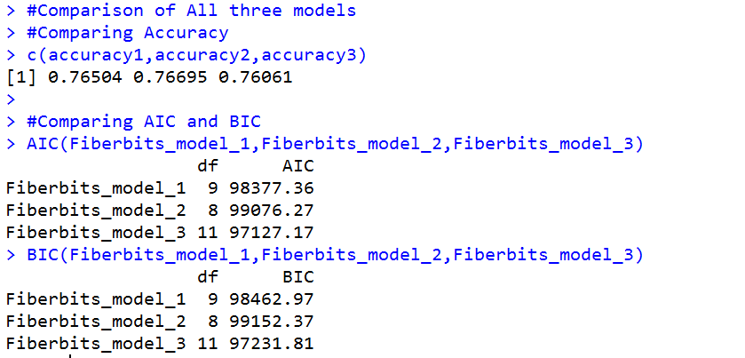
Code-Logistic Regression Model Selection

Slide 54
Conclusion: Logistic
Regression

Slide 55
Conclusion: Logistic Regression
•Logistic Regression is a good foundation for all classification algorithms
•A good understanding on logistic regression and goodness of fit measures will really help in understanding complex machine learning algorithms like neural networks and SVMs
•One has to be careful while selecting the model, all the goodness of fit measures are calculated on training data. We may have to do cross validation to get an idea on the test error

Slide 56
Thank you

